Slide 1
化學科介紹
What is Chemistry ?

Slide 2
What is Chemistry ?
Chemistry studies the composition, structure, & properties of various substances, and the reactions between substances.
Chemists often ask many questions about substances.

Slide 3
What does matter consist of? eg. What is common salt?

Slide 4
Why do different substances have different properties? For example, why is water more mobile than oil?

Slide 5
How do substances react? For example, what happens when the magnesium strip is heated in air?

Slide 6
Why study chemistry？
Chemistry is an indispensable part of our daily lives. Looking around, we can see that many items around us are the result of chemistry research.

Slide 7
Many household items are made of metal, which is chemically extracted from the ore.

Slide 8
Many of our clothes are woven from synthetic fibers, which are made chemically.

Slide 9
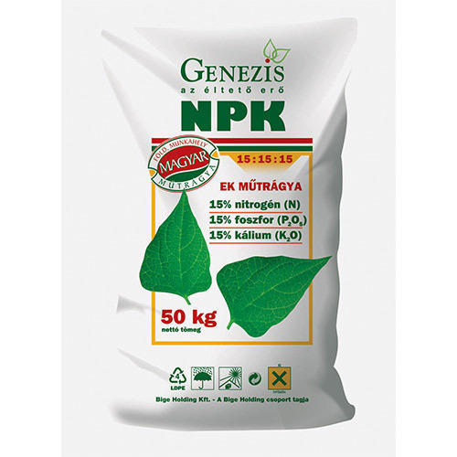
Pesticides and artificial fertilizers that help increase crop yields are made chemically.

Slide 10
The petroleum industry, which fuels cars, ships and aircraft, is an important branch of the chemical industry.

Slide 11
Food additives are chemicals that add aroma and taste to food.

Slide 12
Chemically manufactured drugs can treat diseases and reduce global mortality.

